Slide 1
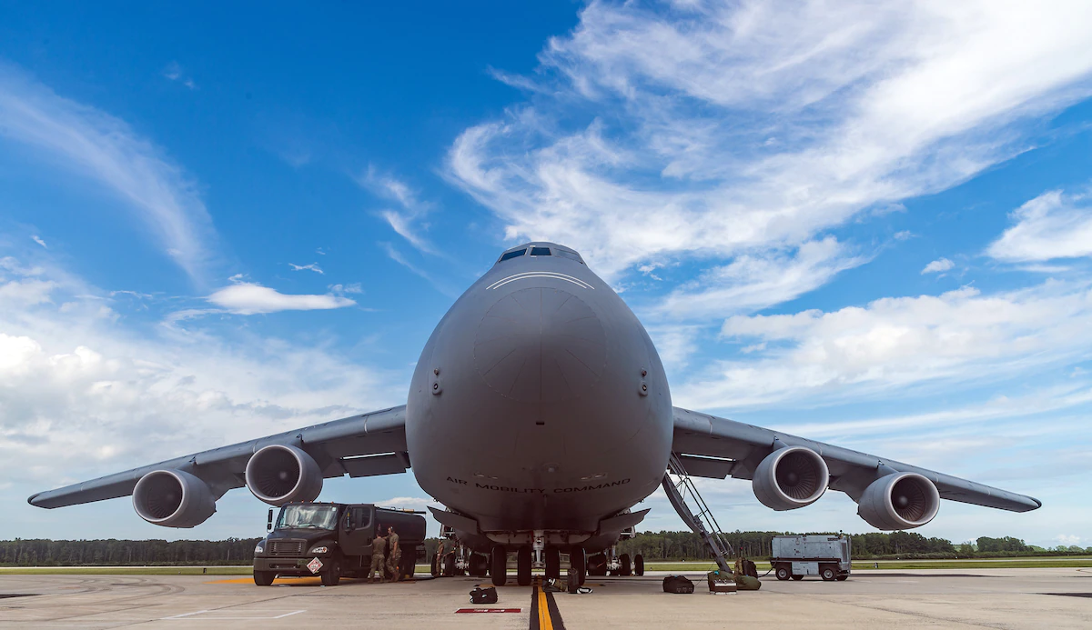


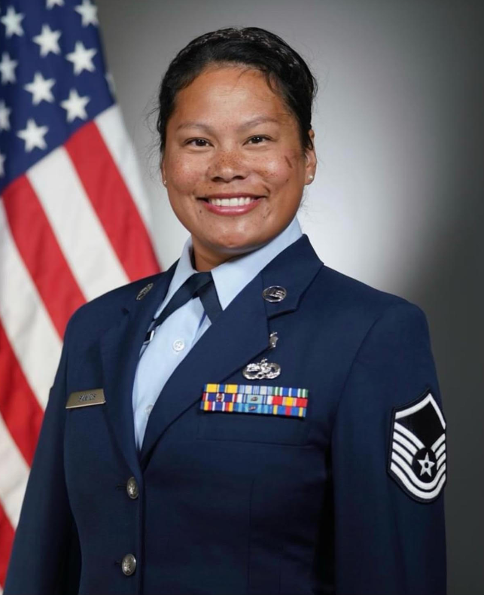

Tracking Sidewinders
Problem Sponsor: 154 MDG DET 1 Defense Mentor: MSGT Santos Business Mentor: Amy Miller
Notes:
Zhi
Good morning everyone we are team tracking sidewinders working with the AIr Force, thank you all for coming today for our presentation today
FIrst we would like to introduce our montor MSGT Santos and Amy Miller

Slide 3

Unit Training Managers (UTMs)
Importance
-Appointed by the unit commander to oversee all unit training
-Serves as a focal point for all training in a unit
-Assists in scheduling training
Without UTMs the Air Force wouldn’t have qualified Airmen to perform the tasks/missions asked of them
“We get people qualified to perform what they’re tasked to do.”
Notes:
Elis

Slide 4






Team Members
Elis Diep Project Manager
Major: Computer Engineering
Patima Poochai Tech Lead
Major: Computer Science
Yhanessa Sales
Business Lead/Tech Lead
Major: Computer Science
Daniel Luong Business Lead
Major: Computer Engineering
Zhixin Li Tech Lead
Major: Computer Science
Notes:
Zhi
Next ill be introducing our team member, my name is zhixin li and ill be the tech lead

Slide 5
Problem Statement
Original Problem Statement: UTMs tracking individuals’ progress across multiple platform, but data is not consolidated and system is not user-friendly. UTMs use these disparate systems along with Excel documents to track all personnel certificates
Final Problem Statement: Multiple redundant manual inputs by UTMs increase chance of human error thus leading to the lack of unit deployment readiness. UTMs need a consolidated platform to use for training/certifications tracking that reduces redundancy and provides automation in possible areas, to increase unit readiness rate.
Notes:
Zhi

Slide 6
Lean Methodology
Preparation
Define Problem + Customer Discovery
MVP Design
Build & Deploy
Discovery
Design
Initial
Deploy
Design MVP based on pains of customers and gains to be provided
Reiterate and slowly change design based on feedback received
Learning Lean Methodology
Interview Questionnaire
Interview takeaways
Interview and validate/change problem according to information received
Notes:
Elis

Slide 7
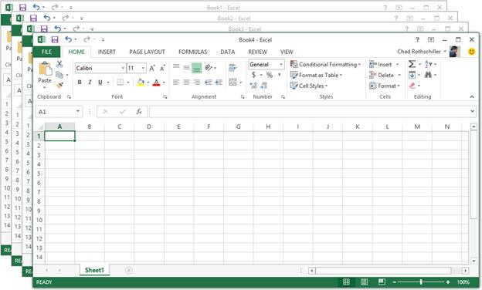

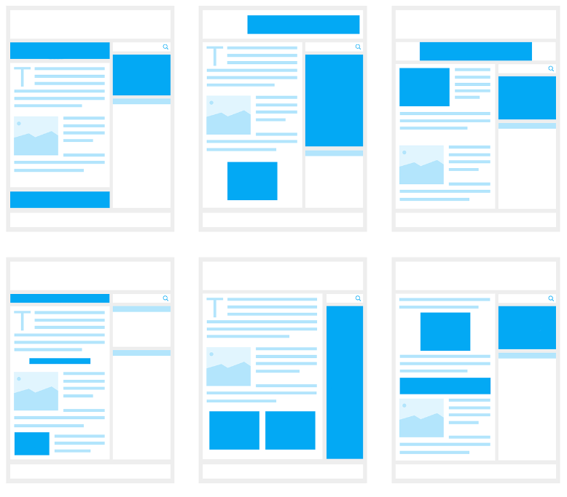
Initial Understanding
+
=
Multiple Platforms (MRDSS, TBA, myTraining, GKO, ArcNet)
-Similar data entered in multiple
Platforms
-Not User-friendly
Personalized Excel Sheets
-Each one has different nuances
-Can only be taught or helped with
-If the other person uses exact one
Repeated Manual Inputs - Some are duplicates
-Higher chance of inaccuracy
-Wasted time repeating
-Any warranted changes require Excel knowledge
Notes:
Elis
Our initial understanding of the problem was that there were many platform that MSgt Santos uses, plus the personalized excel sheet it resulted in wasted time due to repetition into multiple platform and the tediousness of using an excel spreadsheet.

Slide 8







41 Interviews
Unit Training Managers
Airmen
DoD Contractors
Programmers
IT/CyberSecurity
Professors
Program Managers
Notes:
Elis

Slide 9

Initial Findings
Notes:
Maybe add some interviews here

Slide 10








Common Theme from Interview: Multiple Systems/Method
Total Force Training Record
Training Business Area
Notes:
Daniel

Slide 11
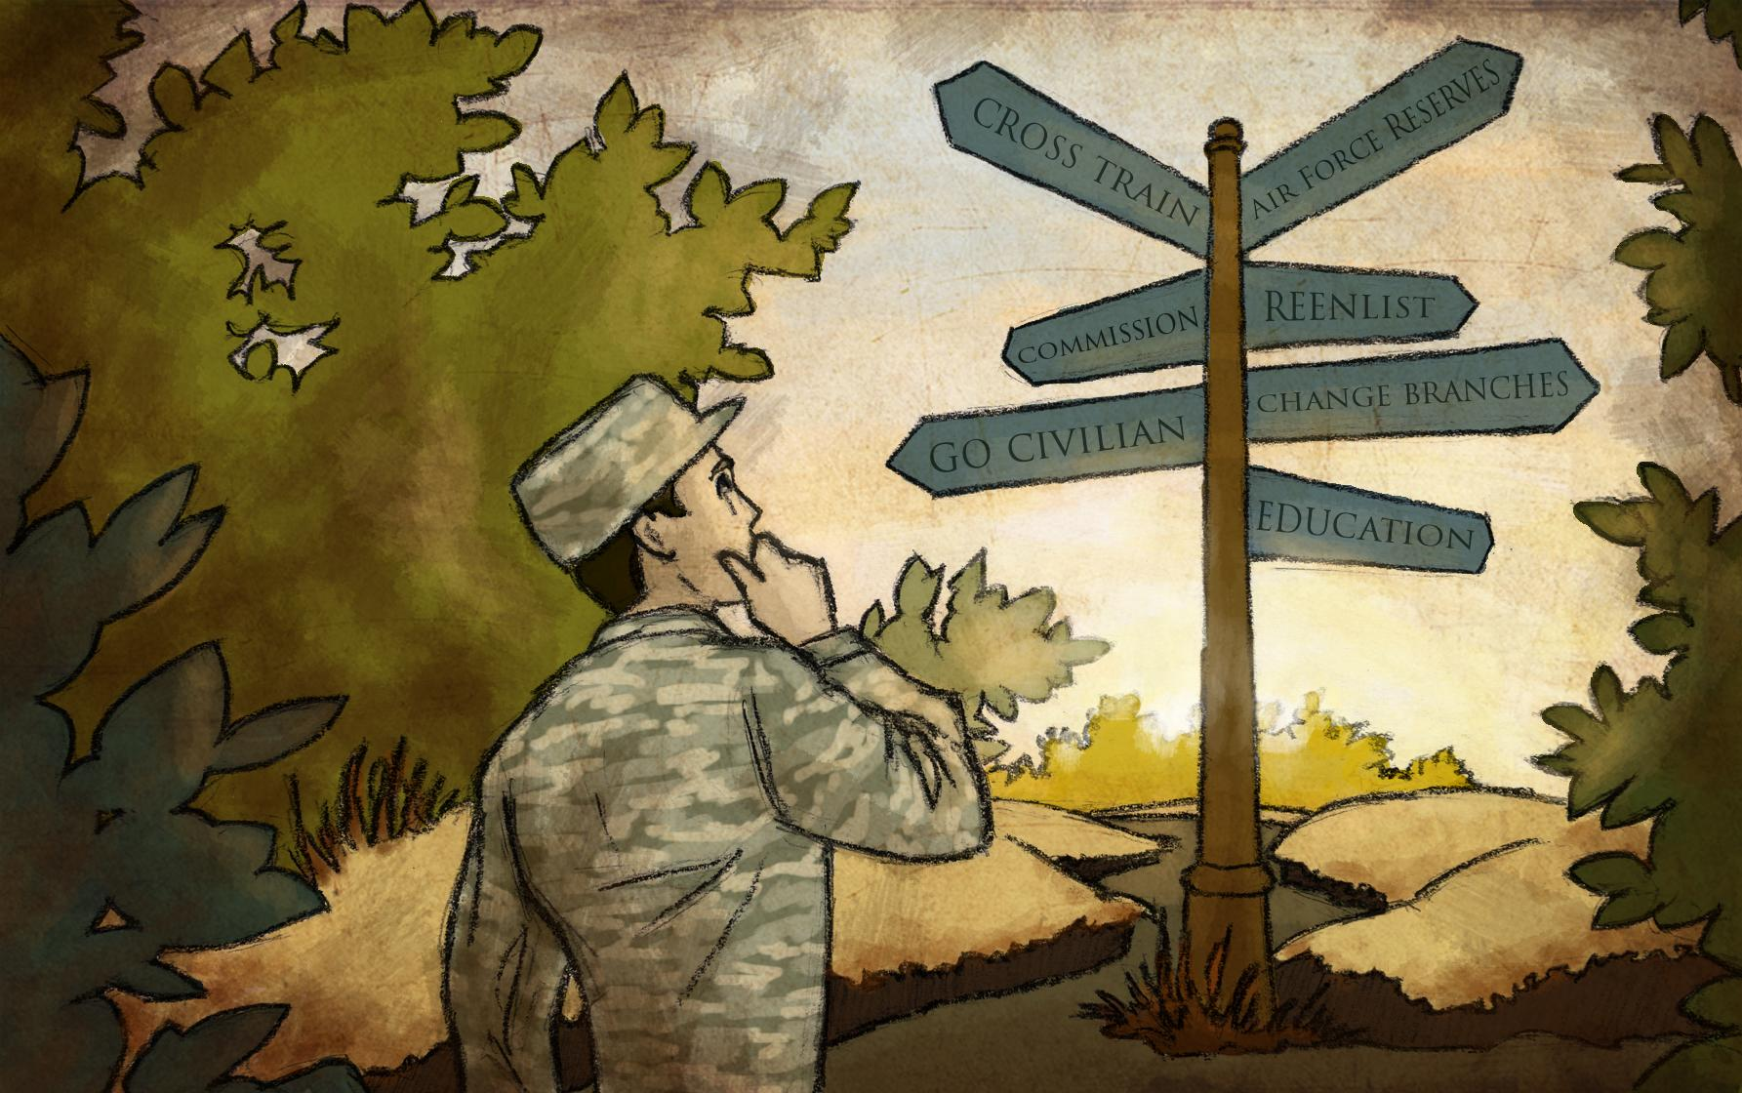
Unit Training Managers(UTMs) Process
UTM Process not the same
Various levels of problem within the UTM community
Inputting/Recording
Read off a Roster Sheet
Some UTM use paper to keep track of training
CAC scan card
Informing Members
Social media messages
Email
Different platforms
Not all UTM uses the same platform
Platform depends what type of unit they are

Slide 12

UTM Process
Joseph Fries:
Tracks: 200+ members
MSgt Santos:
Tracks: 52 members
Gather reports
Gathers reports
Filters the reports and records member’s expired training
Emails report to all the airmen
informs member through various methods and instructions
Email includes instructions on how to complete training
Prepares training
Airmen filters report for their name and finds what training is missing and completes training and uploads it
Airmen completes training and uploads training
UTM uploads data into their systems

Slide 13

Wheeler Base visit
Goals:
Getting a better understanding of the problem.
Confirming current knowledge
Sharing interview findings
Notes:
Daniel

Slide 14
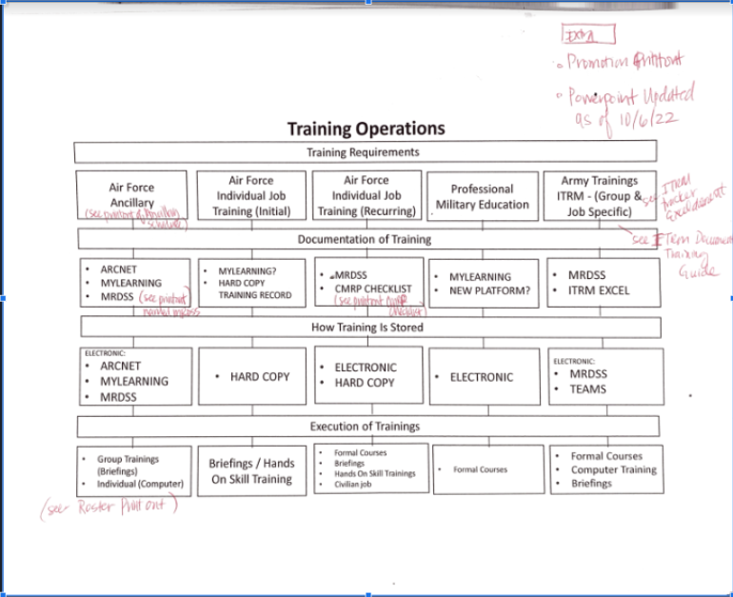
Wheeler Base Findings
Training
5 categories of training
Training have different expiration dates
Different platforms have different saved training
Training stored differently
Distribution of training
Courses
Video
Computer training
Hands on training
Briefings
MSgt Santos routine
Notes:
Daniel

Slide 15
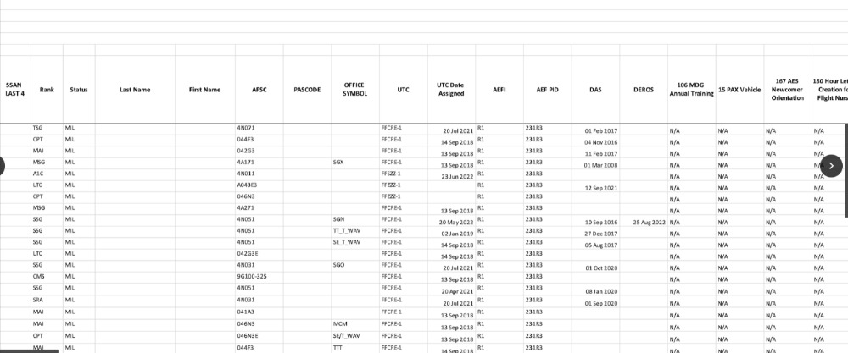
MSgt Santos Excel Sheets

Slide 16
More Interview Findings

Slide 17
Interview Findings
National Guard is harder to implement idea because things usually get implemented active duty down
Medical units had their own separate system for additional Medical certification tracking (MRDSS)
Comsquad filters the bases network access
Medical training will soon be on myTraining-Kyle Strang
Everything is transitioning into MyLearning
Mylearning is being introduced in phases
Different UTM platform for records
Excel
Paper
Earlier notice on training expiration before drill.
Current (Couple days)
Goal ( min week)
“A couple people tried excel, some people that were smarter who could make something better"-Jared Mina(Senior Medic)
“They combined the regulations, so you know what you have to do, but not as specific as in how” -Brian L’esperance(Base Training Manager)

Slide 18
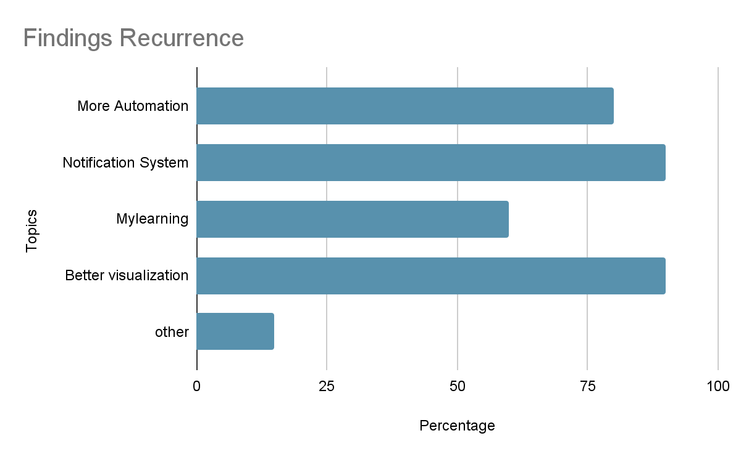
Notes:
Mention Everybody

Slide 19
3 Initial solutions

Slide 20


Initial Solutions/Ideas
Human Resource Management (Off-the-Shelf)
Pros
No maintenance
Proven product
Cons
Higher Budget
Not tailored to beneficiaries
Transition to new platform

Slide 21
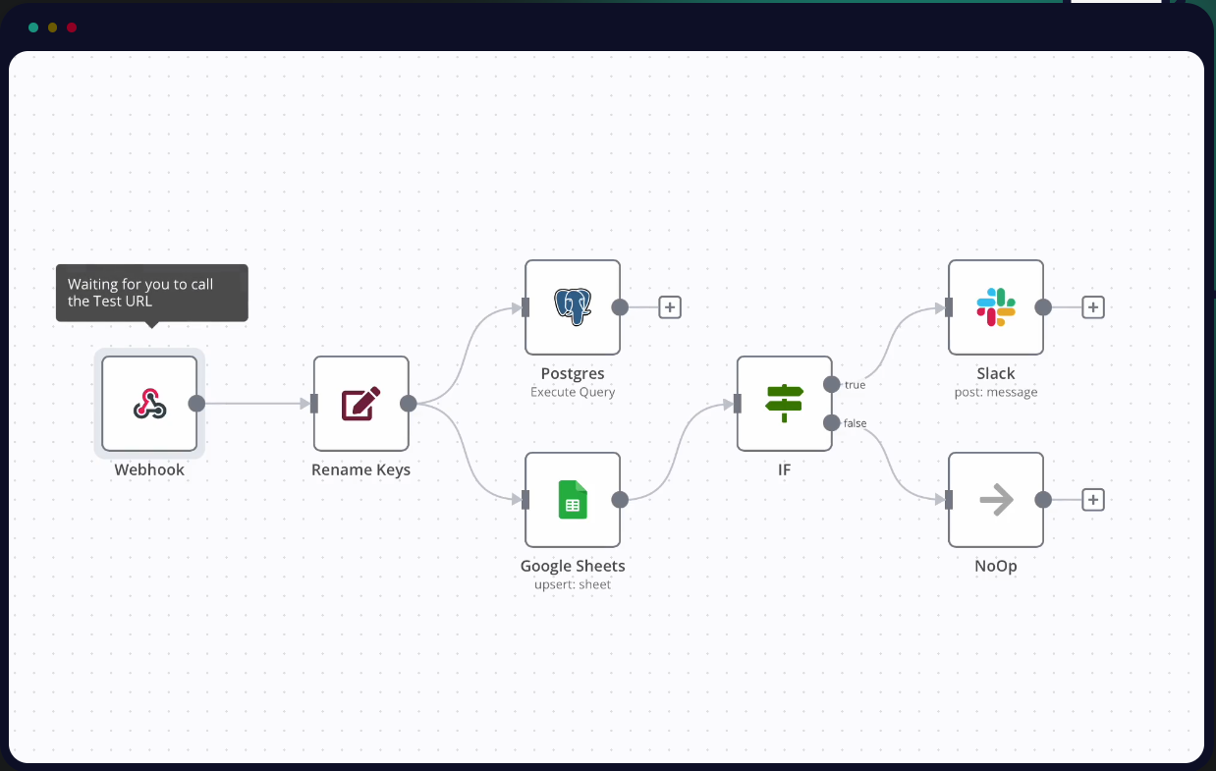
Initial Solutions/Ideas
Workflow Automation
Extend the current system
Excel extensions
Integrate with external systems (optional)
Beehive (automation / notification system)
N8n (Automation System)
Pros
Ease of transition
Less human error
Cons
Uncertainty with automating training platforms’ data access
Notes:
Daniel

Slide 22

Initial Solutions/Ideas
Web App
Goals of the App
Tracking
Notification system
Reporting system
clearance/security
Pros
Consolidation
Customization
Tailored to beneficiaries needs
Cons
Maintenance
Future Updates
Time consuming
Transition to new platform

Slide 23
Conclusion After Interviews + Base Visit
Inputting
-Read off a Roster Sheet
-Some UTM use paper to keep track of training
-Manual Mass Input into system
-Multiple platforms require same submission.
Reporting
-Reports don’t show everything needed, multiple reports needed to access to represent one area
-Bloat, a lot of extra information that is not needed when printing a report
Alerts
-Automated Alerts almost non existent
-Manually send alerts through email, or text,social media
Accessibility
Leaders should be able to keep track of their own squadron
Have to be on base networks
"I wished that something would pop up like an alert"-Multiple Interviewees
“I can see that we have people who have expired training but it’s hard to see the specific individuals” - MSgt Santos(Unit Training Manager)
Notes:
Daniel;

Slide 24

Decision to not use
Human Resource Management (Off-the-Shelf)
-Most are not FEDRamp (Federal Risk and Authorization Management Program) Approved
-Do not have the regulations required for a military training application
-Not enough specific functionality needed for Airforce UTMs
Workflow Automation
-Read/Writing to Platforms will be difficult
-Similarly to Excel, any changes needed will need experience to make changes
-Need permissions/authorizations to even implement
“I’m not sure how you would even write to a platform if it could ” - TSgt John Toms
Notes:
Daniel
Excel Solution Bandaid

Slide 25
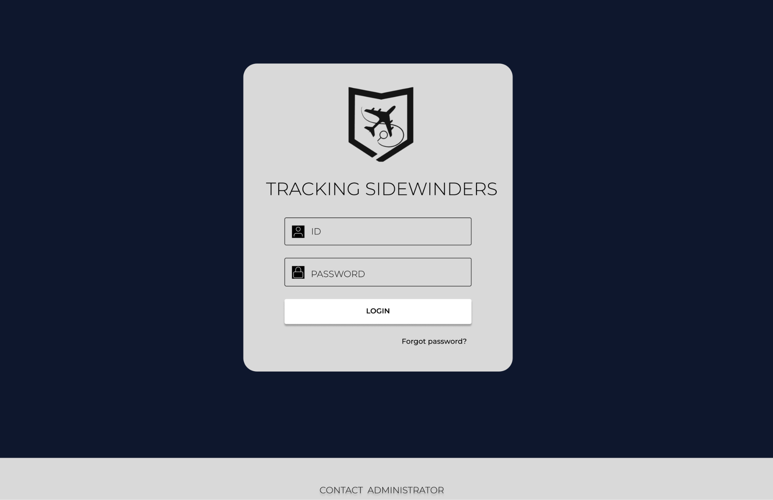
Decision on Web App
Web App
-Similar need of permissions/authorizations to even implement any solution
-Can provide more specific functionality that is needed/asked of
-Any changes/functionality needed can be changed/added by us
-Inputs of different training types would be similar
Notes:
Daniel
Excel Solution Bandaid

Slide 26
Unit Training Managers | Pains | Gains
Consolidated Platform | Many platforms with multiple inputs of duplicate data Different steps they would need to go through for different training/types | Would just need to input information once, less tedious Saving time Reducing human error For each training type, input should be similar
Better Visualization(Reports/ Compliance) | Reports full of bloat Hard to find what you want from report Multiple reports needed for one area Only know who is expired | Color Coordinated for better visualization. Remove redundant data, less time searching Can be see when Airmen might be due ahead of time such as 30-60 days
Automated Alerts | Manual steps taken for alerting(text, email, etc) | Automation provides less input error Saves time for mundane task
Accessibility | Can only access platforms on base networks | With a consolidated system on the Cloud, they should be able to safely access from anywhere with Cac reader
Notes:
Daniel

Slide 27
Airmen | Pains | Gains
Giving Airmen access | Airmen don’t have access to their information, only UTMs | Airmen have more autonomy on their training/certification Better visibility on promotion requirements/trainings needed
Air Force
Consolidated Platform |  | Reduction in the number of platforms running, reducing costs Only need one area(platform) to defend on the Cloud Produce higher compliance rates with airmen training/certification, leading to a higher quality trained airmen ready for deployment
Notes:
Daniel

Slide 28
MISSION MODEL CANVAS (MMC)

Slide 29
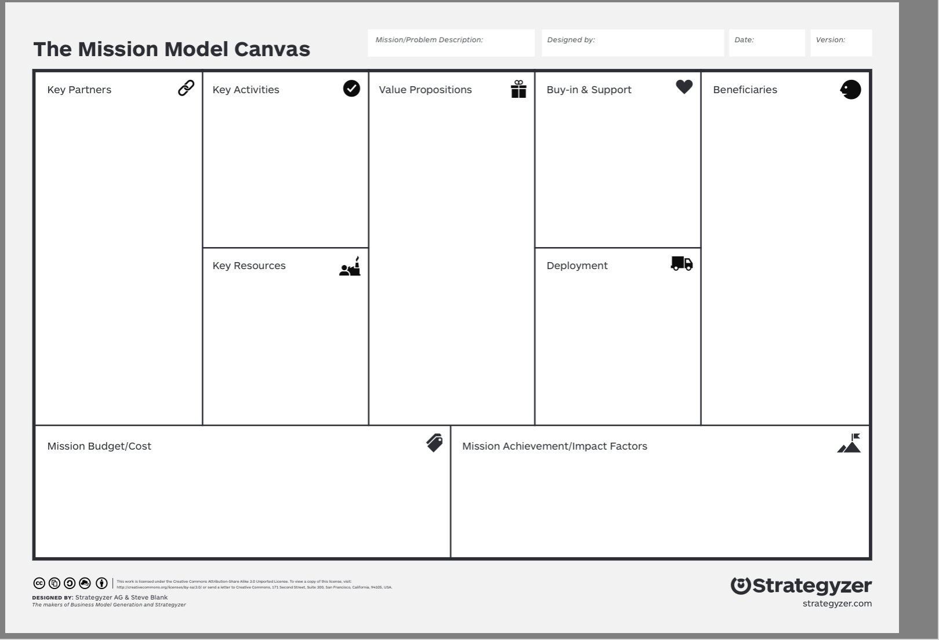

Refer to presentation slides
Team Tracking Sidewinders
06 Dec 2022
Final
UTM Level Solutions
End-to-end solutions: Unit Commander, NGB Level Approval, Joint-Base (Communications squadron) approval
MSgt Santos (Sponsor)
Unit training manager for a CERFP unit (ex. MSgt Morris)
Unit training managers whose unit’s AFSC’s do not exist on the current training platforms
Airmen
Upcoming UTMs
Deployment Monitors/Commanders/Higher Ups
Any Air Force UTM
Any Companies that may use an HR system
Platform Consolidation
Fewer Manual Inputs and Actions
Better Visualization of detachment’s readiness
Non-job specific tracking
Streamlined user interfaces and user interactions
Excel Tool
Fixed: Excel Training, Complex App Development, Data Migration Fee
Monthly: Monthly Seat Fee/Contract Fee, Cloud Hosting, IT?Maintenance Workers, Recurring Security Checks
Total: $683,400 Initial Fees + $565,400/month
Reduction of time to upload training into a system
Positive feedback
More automation than current system
More efficient way of collecting servicemen's completion
Notes:
Pat

Slide 30
Beneficiaries
Refer to presentation slides
Team Tracking Sidewinders
06 Dec 2022
Final
Primary:
MSgt Santos (Sponsor)
Unit training manager for a CERFP unit (ex: MSgt Morris)
Secondary:
Unit training managers whose unit’s AFSC’s do not exist on the current training platforms
Airmen
Deployment Monitors/Commanders/Higher Ups
Tertiary:
Other Air Force or ANG UTM
Beyond:
Any organization that may need a similar HR system
Platform Consolidation
Fewer Manual Inputs and Actions
Better Visualization of detachment’s readiness
Non-job specific tracking
Streamlined user interfaces and user interactions
Excel Tool
UTM Level Solutions
End-to-end solutions: Unit Commander, NGB Level Approval, Joint-Base (Communications squadron) approval
MSgt Santos (Sponsor)
Unit training manager for a CERFP unit (ex. MSgt Morris)
Unit training managers whose unit’s AFSC’s do not exist on the current training platforms
Airmen
Upcoming UTMs
Deployment Monitors/Commanders/Higher Ups
Any Air Force UTM
Any Companies that may use an HR system
Fixed: Excel Training, Complex App Development, Data Migration Fee
Monthly: Monthly Seat Fee/Contract Fee, Cloud Hosting, IT?Maintenance Workers, Recurring Security Checks
Total: $683,400 Initial Fees + $565,400/month
Reduction of time to upload training into a system
Positive feedback
More automation than current system
More efficient way of collecting servicemen's completion
Notes:
Pat

Slide 31
Mission Achievement/Impact Factors
Refer to presentation slides
Team Tracking Sidewinders
06 Dec 2022
Final
Platform Consolidation
Fewer Manual Inputs and Actions
Better Visualization of detachment’s readiness
Non-job specific tracking
Streamlined user interfaces and user interactions
Excel Tool
UTM Level Solutions
End-to-end solutions: Unit Commander, NGB Level Approval, Joint-Base (Communications squadron) approval
MSgt Santos (Sponsor)
Unit training manager for a CERFP unit (ex. MSgt Morris)
Unit training managers whose unit’s AFSC’s do not exist on the current training platforms
Airmen
Upcoming UTMs
Deployment Monitors/Commanders/Higher Ups
Any Air Force UTM
Any Companies that may use an HR system
Reduction of Time to uploading training into a system
Currently: 15 - 20 minutes for uploading roster training
Expected: 5 - 10 minutes for uploading roster training
Feedback
How more efficient the system is compared to current system .
The use of the system is less stressful to use
Fixed: Excel Training, Complex App Development, Data Migration Fee
Monthly: Monthly Seat Fee/Contract Fee, Cloud Hosting, IT?Maintenance Workers, Recurring Security Checks
Total: $683,400 Initial Fees + $565,400/month
Reduction of time to upload training into a system
Positive feedback
More automation than current system
More efficient way of collecting servicemen's completion
Notes:
Pat

Slide 32
Mission Achievement/Impact Factors
Refer to presentation slides
Team Tracking Sidewinders
06 Dec 2022
Final
Platform Consolidation
Fewer Manual Inputs and Actions
Better Visualization of detachment’s readiness
Non-job specific tracking
Streamlined user interfaces and user interactions
Excel Tool
UTM Level Solutions
End-to-end solutions: Unit Commander, NGB Level Approval, Joint-Base (Communications squadron) approval
MSgt Santos (Sponsor)
Unit training manager for a CERFP unit (ex. MSgt Morris)
Unit training managers whose unit’s AFSC’s do not exist on the current training platforms
Airmen
Upcoming UTMs
Deployment Monitors/Commanders/Higher Ups
Any Air Force UTM
Any Companies that may use an HR system
3. More automation
Emails to update airmen training
Loading roster to the system
4. More efficient way of collecting airmen tempsattendance
Updated roster system and less old fashioned system (paper)
Fixed: Excel Training, Complex App Development, Data Migration Fee
Monthly: Monthly Seat Fee/Contract Fee, Cloud Hosting, IT?Maintenance Workers, Recurring Security Checks
Total: $683,400 Initial Fees + $565,400/month
Reduction of time to upload training into a system
Positive feedback
More automation than current system
More efficient way of collecting servicemen's completion
Notes:
Pat

Slide 33
Value Propositions
Refer to presentation slides
Team Tracking Sidewinders
06 Dec 2022
Final
1. Platform consolidation
Combine all other training platforms into a all in ONE HUB
Collect all needed functionalities from 5 training platforms into ONE SOFTWARE
Consolidated security monitoring
Only ONE APPLICATION to manage, maintain, and regulate
LOWERING costs, manpower, time to run the current system
Further REDUCE TIME by number of current platforms used to just one
Platform Consolidation
Fewer Manual Inputs and Actions
Better Visualization of detachment’s readiness
Non-job specific tracking
Streamlined user interfaces and user interactions
Excel Tool
UTM Level Solutions
End-to-end solutions: Unit Commander, NGB Level Approval, Joint-Base (Communications squadron) approval
Primary:
MSgt Santos (Sponsor)
Unit training manager for a CERFP unit (ex. MSgt Morris)
Secondary:
Unit training managers whose unit’s AFSC’s do not exist on the current training platforms
Airmen
Upcoming UTMs
Deployment Monitors/Commanders/Higher Ups
Tertiary:
Any Air Force UTM
Beyond:
Any Companies that may use an HR system
Fixed: Excel Training, Complex App Development, Data Migration Fee
Monthly: Monthly Seat Fee/Contract Fee, Cloud Hosting, IT?Maintenance Workers, Recurring Security Checks
Total: $683,400 Initial Fees + $565,400/month
Reduction of time to upload training into a system
Positive feedback
More automation than current system
More efficient way of collecting servicemen's completion
Notes:
Pat

Slide 34
-Not enough specific functionality needed for Airforce UTMs
Value Propositions
Refer to presentation slides
Team Tracking Sidewinders
06 Dec 2022
Final
2. Fewer manual inputs and actions
AUTOMATED ALERT system to UTM
ONE CLICK SEND and automated notifications sent to expired servicemembers
QUICK FILTERING systems to filter needed info for UTM (expired, due soon, one squad only)
Platform Consolidation
Fewer Manual Inputs and Actions
Better Visualization of detachment’s readiness
Non-job specific tracking
Streamlined user interfaces and user interactions
Excel Tool
UTM Level Solutions
End-to-end solutions: Unit Commander, NGB Level Approval, Joint-Base (Communications squadron) approval
Primary:
MSgt Santos (Sponsor)
Unit training manager for a CERFP unit (ex. MSgt Morris)
Secondary:
Unit training managers whose unit’s AFSC’s do not exist on the current training platforms
Airmen
Upcoming UTMs
Deployment Monitors/Commanders/Higher Ups
Tertiary:
Any Air Force UTM
Beyond:
Any Companies that may use an HR system
Fixed: Excel Training, Complex App Development, Data Migration Fee
Monthly: Monthly Seat Fee/Contract Fee, Cloud Hosting, IT?Maintenance Workers, Recurring Security Checks
Total: $683,400 Initial Fees + $565,400/month
Reduction of time to upload training into a system
Positive feedback
More automation than current system
More efficient way of collecting servicemen's completion
Notes:
Pat

Slide 35
Value Propositions
Refer to presentation slides
Team Tracking Sidewinders
06 Dec 2022
Final
3. Better visualization of the tempdetachment’s readiness
COLORED graphs and charts for quicker assessment of readiness
Better reporting of the current state of trainings to the higher ups
4. Non-job specific tracking
5. Streamlined user interfaces and tempuser interactions
EASY to learn, user friendly interfaces
QUICKER/EFFICIENT uploading mass data
Platform Consolidation
Fewer Manual Inputs and Actions
Better Visualization of detachment’s readiness
Non-job specific tracking
Streamlined user interfaces and user interactions
Excel Tool
UTM Level Solutions
End-to-end solutions: Unit Commander, NGB Level Approval, Joint-Base (Communications squadron) approval
Primary:
MSgt Santos (Sponsor)
Unit training manager for a CERFP unit (ex. MSgt Morris)
Secondary:
Unit training managers whose unit’s AFSC’s do not exist on the current training platforms
Airmen
Upcoming UTMs
Deployment Monitors/Commanders/Higher Ups
Tertiary:
Any Air Force UTM
Beyond:
Any Companies that may use an HR system
Fixed: Excel Training, Complex App Development, Data Migration Fee
Monthly: Monthly Seat Fee/Contract Fee, Cloud Hosting, IT?Maintenance Workers, Recurring Security Checks
Total: $683,400 Initial Fees + $565,400/month
Reduction of time to upload training into a system
Positive feedback
More automation than current system
More efficient way of collecting servicemen's completion
Notes:
Pat

Slide 36
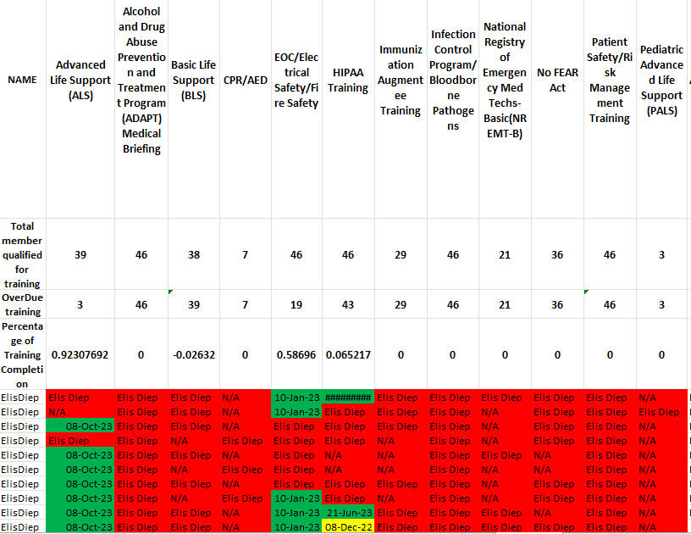
Value Propositions
Refer to presentation slides
Team Tracking Sidewinders
06 Dec 2022
Final
6. Better visualization of output
Display percentage of each training COMPLETE
ONE sheet that has the output of 5 reports
REMOVE UNNECESSARY data
Platform Consolidation
Fewer Manual Inputs and Actions
Better Visualization of detachment’s readiness
Non-job specific tracking
Streamlined user interfaces and user interactions
Excel Tool
UTM Level Solutions
End-to-end solutions: Unit Commander, NGB Level Approval, Joint-Base (Communications squadron) approval
Primary:
MSgt Santos (Sponsor)
Unit training manager for a CERFP unit (ex. MSgt Morris)
Secondary:
Unit training managers whose unit’s AFSC’s do not exist on the current training platforms
Airmen
Upcoming UTMs
Deployment Monitors/Commanders/Higher Ups
Tertiary:
Any Air Force UTM
Beyond:
Any Companies that may use an HR system
Fixed: Excel Training, Complex App Development, Data Migration Fee
Monthly: Monthly Seat Fee/Contract Fee, Cloud Hosting, IT?Maintenance Workers, Recurring Security Checks
Total: $683,400 Initial Fees + $565,400/month
Reduction of time to upload training into a system
Positive feedback
More automation than current system
More efficient way of collecting servicemen's completion
Notes:
Pat

Slide 37
Market Size
Addressable Market | Main beneficiary size | Likelihood of sharing addressable problems
MSGT Santos’s detachment | UTMs in the unit | High
Cross-enterprise ANG CBRN | 17 units, 1+ UTM per unit | High/Medium
ANG Medical Groups | Unknown, <668 units (1+ UTM/unit) | Medium
ANG all units | 668 units: 89 flying, 579 support, (1+ UTM/unit) | Medium
Air Force Full-time and ANG all units | 10 MAJCOM + ANG | Very Low
Final
Refer to presentation slides
Team Tracking Sidewinders
06 Dec 2022
Platform Consolidation
Fewer Manual Inputs and Actions
Better Visualization of detachment’s readiness
Non-job specific tracking
Streamlined user interfaces and user interactions
Excel Tool
UTM Level Solutions
End-to-end solutions: Unit Commander, NGB Level Approval, Joint-Base (Communications squadron) approval
Primary:
MSgt Santos (Sponsor)
Unit training manager for a CERFP unit (ex. MSgt Morris)
Secondary:
Unit training managers whose unit’s AFSC’s do not exist on the current training platforms
Airmen
Upcoming UTMs
Deployment Monitors/Commanders/Higher Ups
Tertiary:
Any Air Force UTM
Beyond:
Any Companies that may use an HR system
Fixed: Excel Training, Complex App Development, Data Migration Fee
Monthly: Monthly Seat Fee/Contract Fee, Cloud Hosting, IT?Maintenance Workers, Recurring Security Checks
Total: $683,400 Initial Fees + $565,400/month
Reduction of time to upload training into a system
Positive feedback
More automation than current system
More efficient way of collecting servicemen's completion
Notes:
Pat

Slide 38
FIXED | Cost | Total Cost
Excel Training | $50 Per Course | One Time $33,400
Complex App Development | Starts at $150,000 | One Time $150,000
Data Migration Fee | Bigger Workloads can be $500,000 | One Time $500,000
MONTHLY
Monthly Seat Fee/Contract Fee | $4 per User(107,414 NG airmen) | ~$430,000 / Month
Cloud Hosting | Larger platforms start at $9,455 a Month | ~$10,000/Month
IT/Maintenance Workers | Based off 1 IT Manager + 2 JR IT Needed Per 125 Person | ~$125,000 / Month
Recurring Security Checks | $400 a Month | ~$400 a Month
Mission Budget/Cost
Refer to presentation slides
Team Tracking Sidewinders
06 Dec 2022
Final
Platform Consolidation
Fewer Manual Inputs and Actions
Better Visualization of detachment’s readiness
Non-job specific tracking
Streamlined user interfaces and user interactions
Excel Tool
UTM Level Solutions
End-to-end solutions: Unit Commander, NGB Level Approval, Joint-Base (Communications squadron) approval
Primary:
MSgt Santos (Sponsor)
Unit training manager for a CERFP unit (ex. MSgt Morris)
Secondary:
Unit training managers whose unit’s AFSC’s do not exist on the current training platforms
Airmen
Upcoming UTMs
Deployment Monitors/Commanders/Higher Ups
Tertiary:
Any Air Force UTM
Beyond:
Any Companies that may use an HR system
$683,400/ + $565,400/Month
Fixed: Excel Training, Complex App Development, Data Migration Fee
Monthly: Monthly Seat Fee/Contract Fee, Cloud Hosting, IT?Maintenance Workers, Recurring Security Checks
Total: $683,400 Initial Fees + $565,400/month
Reduction of time to upload training into a system
Positive feedback
More automation than current system
More efficient way of collecting servicemen's completion
Notes:
Pat

Slide 39
Solutions

Slide 40
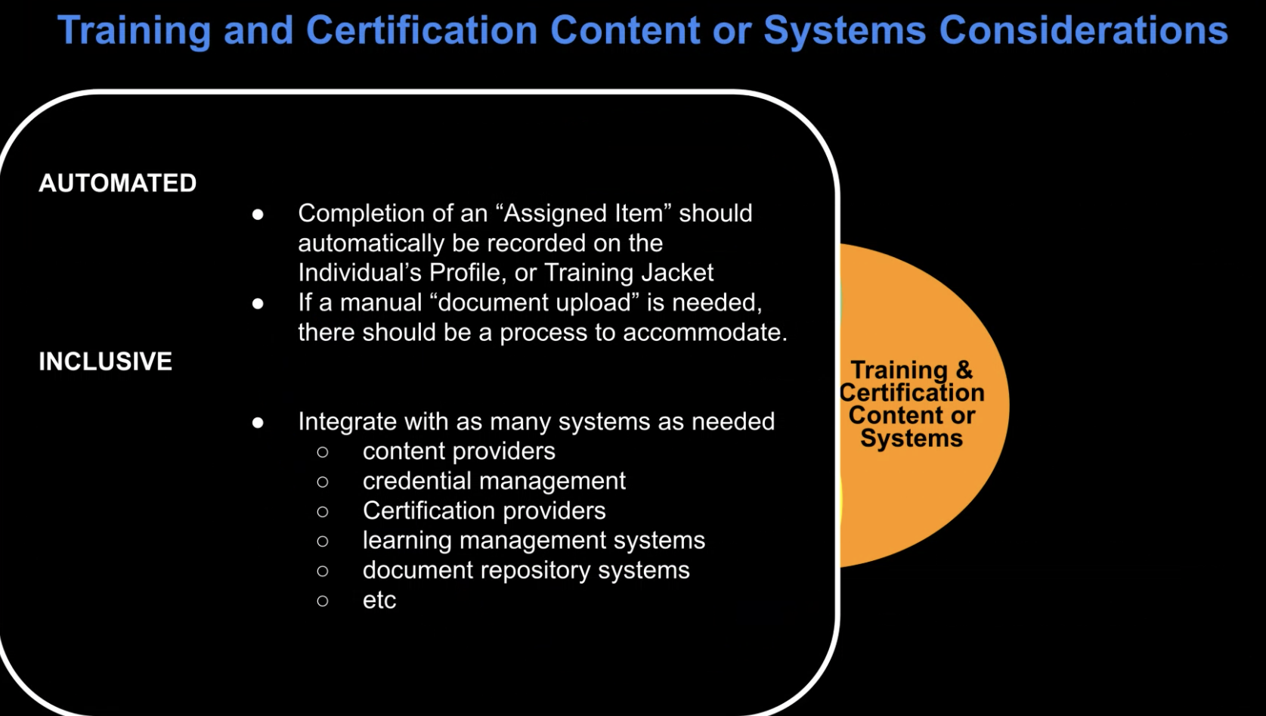
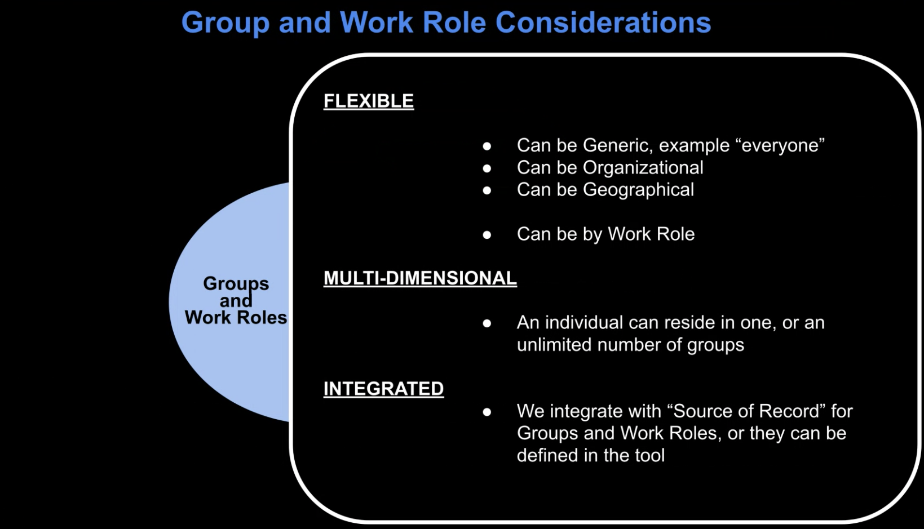
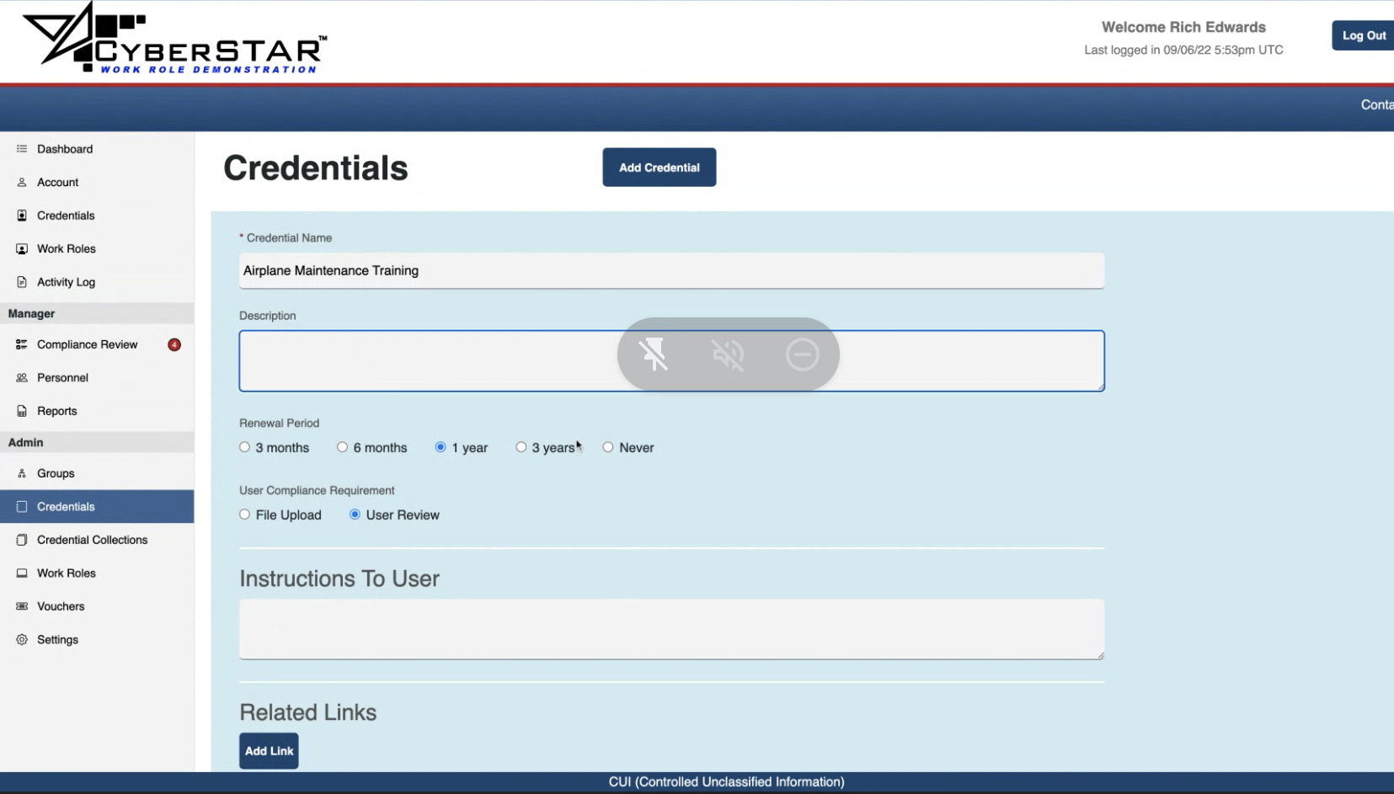
DoD Contractor
5 Major Components of Workforce Management Tracking
-WorkForce
-Groups and Roles
-Training and Certification Requirements
-Training and Certification Content or Systems
-Complex Inter-Relationships
“If I’m this rank then I should be able to see every unit on base, not just my own” - TSgt John Toms - Training Manager
Notes:
yhanessa

Slide 41
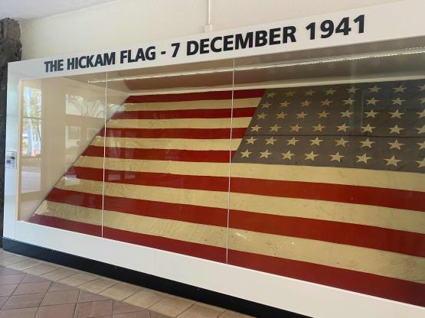
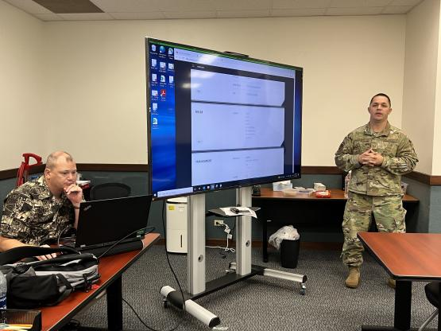
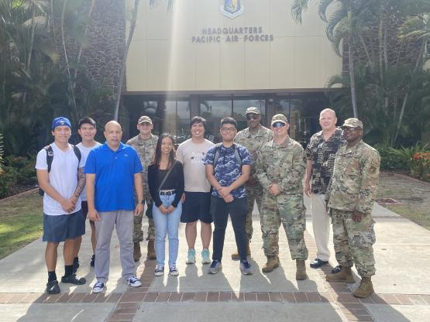

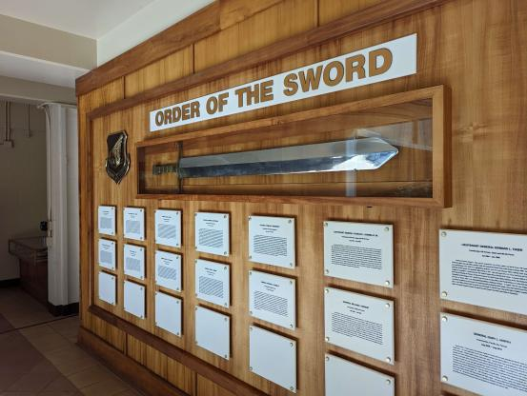
Hickam Base
Goals:
Feedback of the M.V.P
Notes:
yhanessa
2nd base visit
Getting more feedback on our mvp
Finding out about TRON, OKTA, and other requirements that we didn’t know

Slide 42
M.V.P
https://h4dapp.bubbleapps.io/version-test/home_dashboard

Slide 43
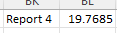
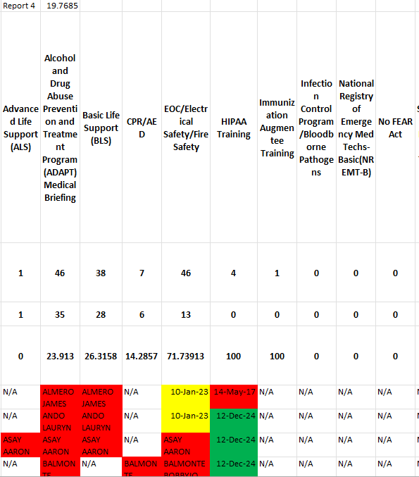
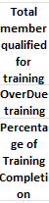
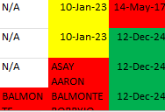
Excel Solution
Not a permanent fix but a tool for MSgt Santos to use.
Enhanced capabilities of Excel come from enhanced knowledge
Gains
One report instead of 5
Better Visualization
Removed excess data
Display percentages
Display names of person who are missing training
Display when training is due
Color coordinated
Overdue
Coming up
Good
Notes:
We also created an excel solution for MSgt Santos.It is not a permanent fix but a tool for her to use. It should organize her reports and give MSgt santos better visuals compared to her original ones. I was able to create an output spreadsheet that takes in the 5 reports that MSgt Santos receives. It removes the excess data and displays the percentage completion of each individual training and overall reports. The spreadsheet also displays the calculated expiration date of the trainings and names of the airmen who are due for training. So it is easy for MSgt to track down. It is also color coordinated so red mean overdue, yellow mean upcoming and green means good.

Slide 44


This isn’t New
Samantha Kunzelman, TSgt, USAFAFRL Det 1 Unit Training Manager Comparison of two systems used at The time AFTR and TBA Systems had 61 common functions, TBA 23 unique functions, 16 unique for AFTR | … platform’s vision is to centralize LMS platforms across the force and allow the student to access multiple databases and training curriculum with a single login, which eliminates the need for Airmen to have multiple passwords for access. | … ensure that the products being built will benefit the end user by reducing the manual processes and task saturation that many Airmen face in their day to day jobs.
Notes:
Daniel

Slide 45

End Points
Military will not take in two contracts that compete with each other(Except they already have contract for new platform)
Contractor does not take into inputs of common airmen or UTMs

Slide 46
Thank You
Director H4D: Gloria Choo
Instructor: Jeff Hui
Mentor: MSgt Santos
Attendees

Slide 47
Authentication
Notes:
Patrick doing all of the MVP
We built our proposed solution with consideration that this is how “ideally” our solution should work, and not considering the actual nuances of implementation
For the sake of completing MVP, we are not using something like OKTA for authentication

Slide 48
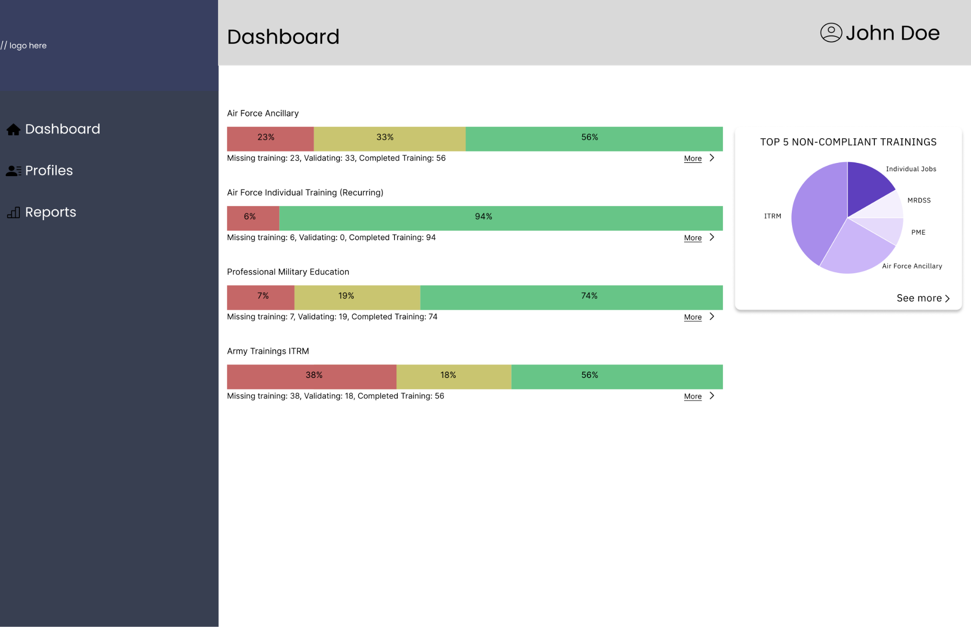
Dashboard Visualization
Gain: Better Visualization for UTMs
“You’re already way ahead of what we have with these charts” - TSgt John Toms - Training Manager
Notes:
The first gain of our solution is better visualization
UTMs can quickly see the overall state of their unit’s training, and see the most non-compliant trainings
Our charts received Positive feedback from Hickam base visit

Slide 49
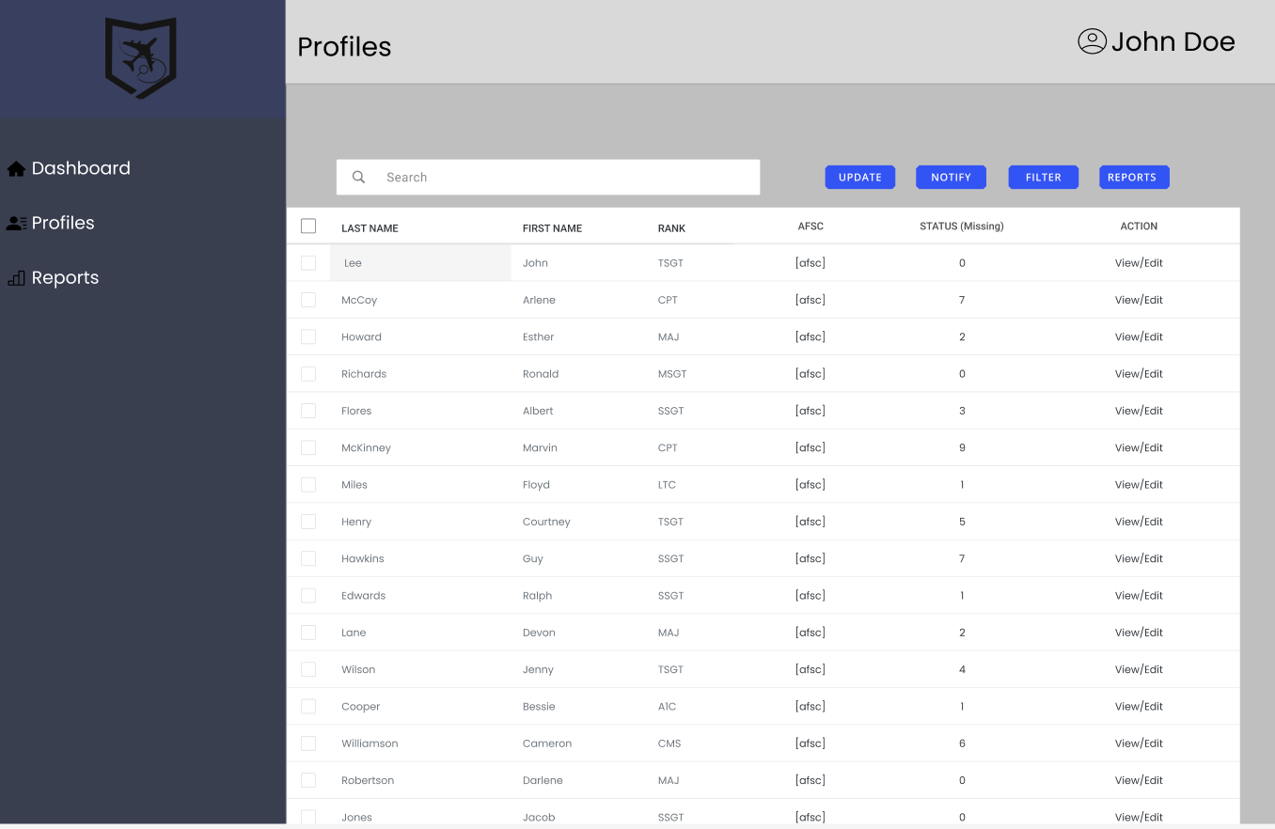
Profiles List
Gains:
Most needed filtering
EDIP
AFSC
PAS
Work Center
Due soon
Expired
1-click notify
Notify all airman with expired trainings
Notes:
UTMs can see the details of their training management in the profile list page
The page has Filters based on most relevant fields: EDIP, AFSC, PAS, Work center, expired and due soon training
Another gain is the ability to quickly notify all expired aiman without taking time to look at the data and write emails to individual servicemembers

Slide 50
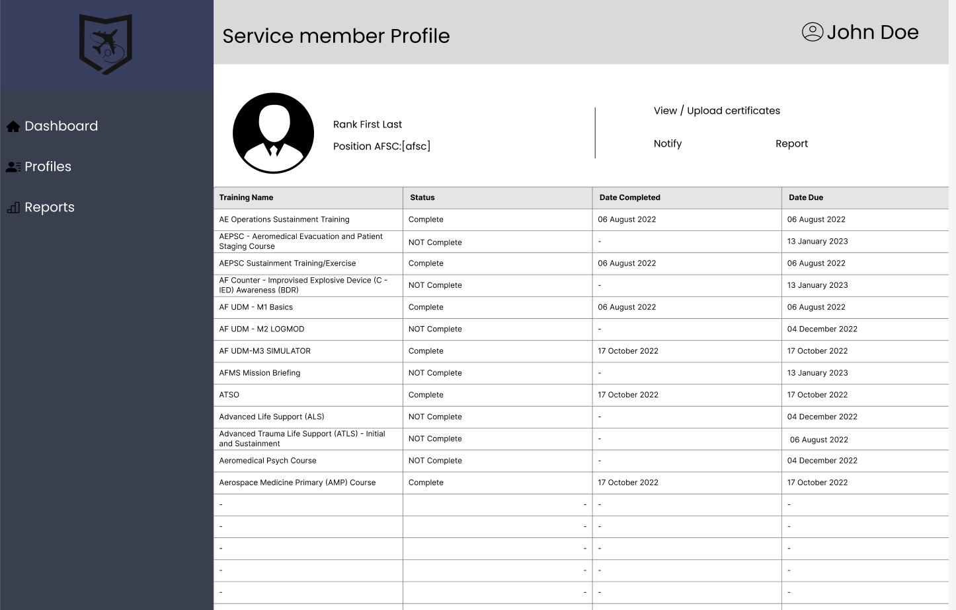
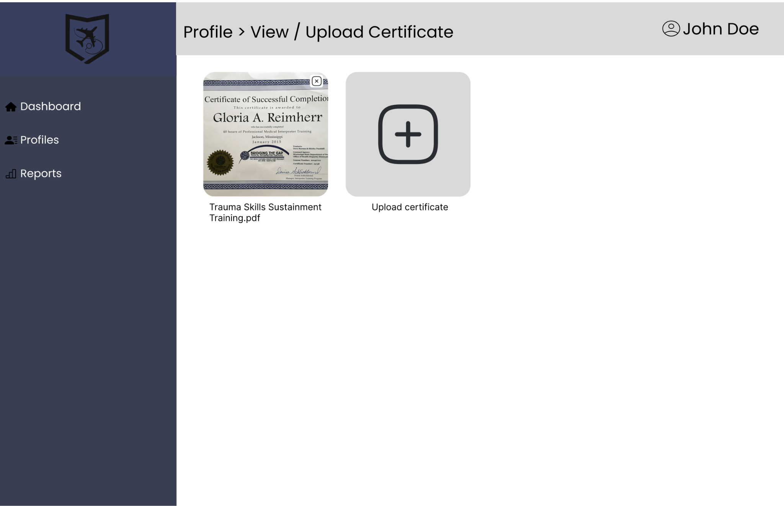
Service Member Profile
Notes:
Servicemember profile page consolidate information for each airman
UTMs can see status of individual airman’s training
We also created a certificate storage page, where all certifications are in one place
UTMs can upload / download certificates

Slide 51
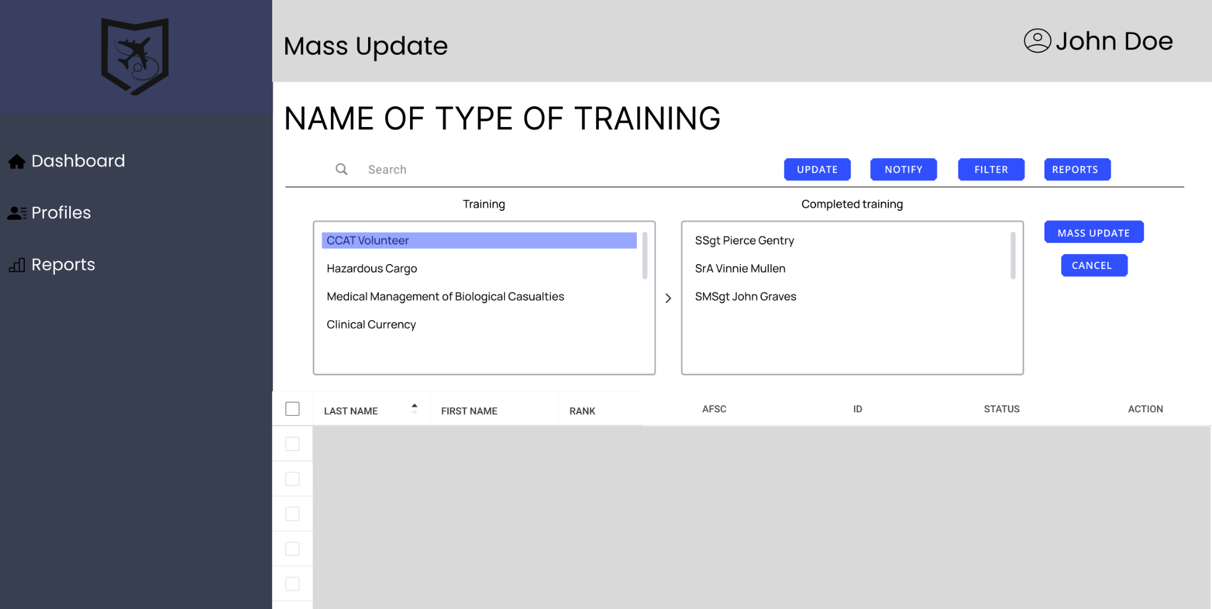
Mass Training Update
Used similar mass Training Update as current
“We don’t have a notification
system”
Gain: Automated Mass or Single Notification
Notes:
We also created the mass training update page
Gain: This page automate and streamline the process of sending out notifications to a select group of people
In our proposed solution, this page would be able to apply updates to all legacy platform: MRDSS, ITRM, other databases, saving UTMs having to enter the data multiple times

Slide 52
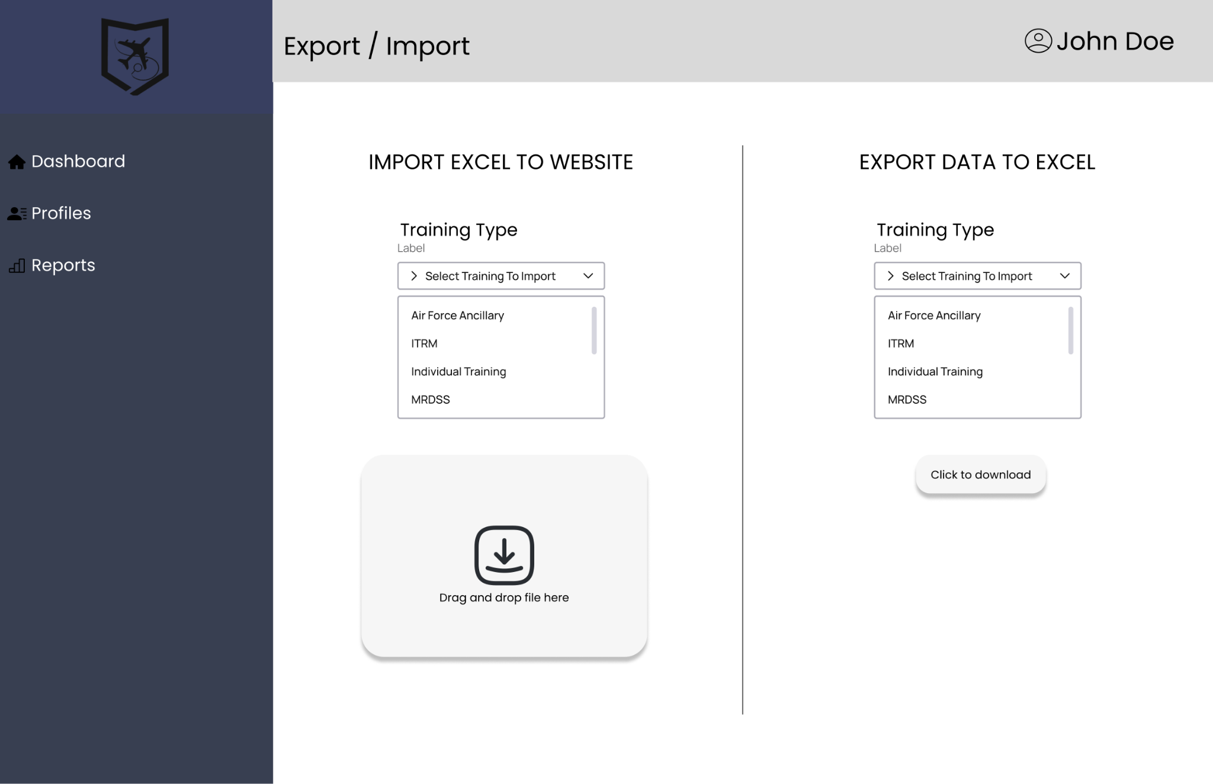

Excel Report Import / Export
Gain: Easy integration with legacy system
Download and upload excel files
Notes:
UTMs can upload legacy excel files to Integrate our solution with the current system
UTMs can also download the database as a excel file for creating reports

Slide 53
DEMO
https://main.d32ai1lyqme0q3.amplifyapp.com/

Slide 54
Decision on built App
Human Resource Management (Off-the-Shelf)
-Most are not FEDRamp (Federal Risk and Authorization Management Program) Approved
-Do not have the regulations required for a military training application
-Not enough specific functionality needed for Airforce UTMs
Workflow Automation
Web App
-Similar need of permissions/authorizations to even implement
-Can provide more specific functionality that is needed
-Any changes can be implemented into the platform
-Just as/or less complex than building a platform that pulls data from current systems
-Read/Writing to Platforms will be difficult
-Similarly to Excel, any changes needed will need experience to make changes
-Need permissions/authorizations to even implement
“I’m not sure how you would even write to a platform if it could ” - TSgt John Toms
Notes:
Daniel
Excel Solution Bandaid

